Slide 1
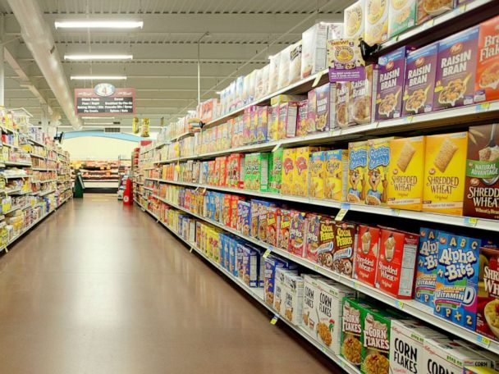
CS PROJECT
BILLING SOFTWARE FOR A GROCERY STORE

Slide 2
ABOUT THE PROGRAM
PROGRAMMING LANGUAGE USED: PYTHON
MODULES USED: TKINTER AND PANDAS
Tkinter is used to implement this GUI
The list of the products and the registered customers is stored in the form of an excel file.
The user enters customer ID and selects items from the list of products.
Along with this, the user also gets to select the quality and quantity of the each product.
User can generate the bill after selecting the above mentioned options.
The bill will contain the total numbers of products purchased , total quantity and total amount.
The program also generates discount for all the registered customers .

Slide 3
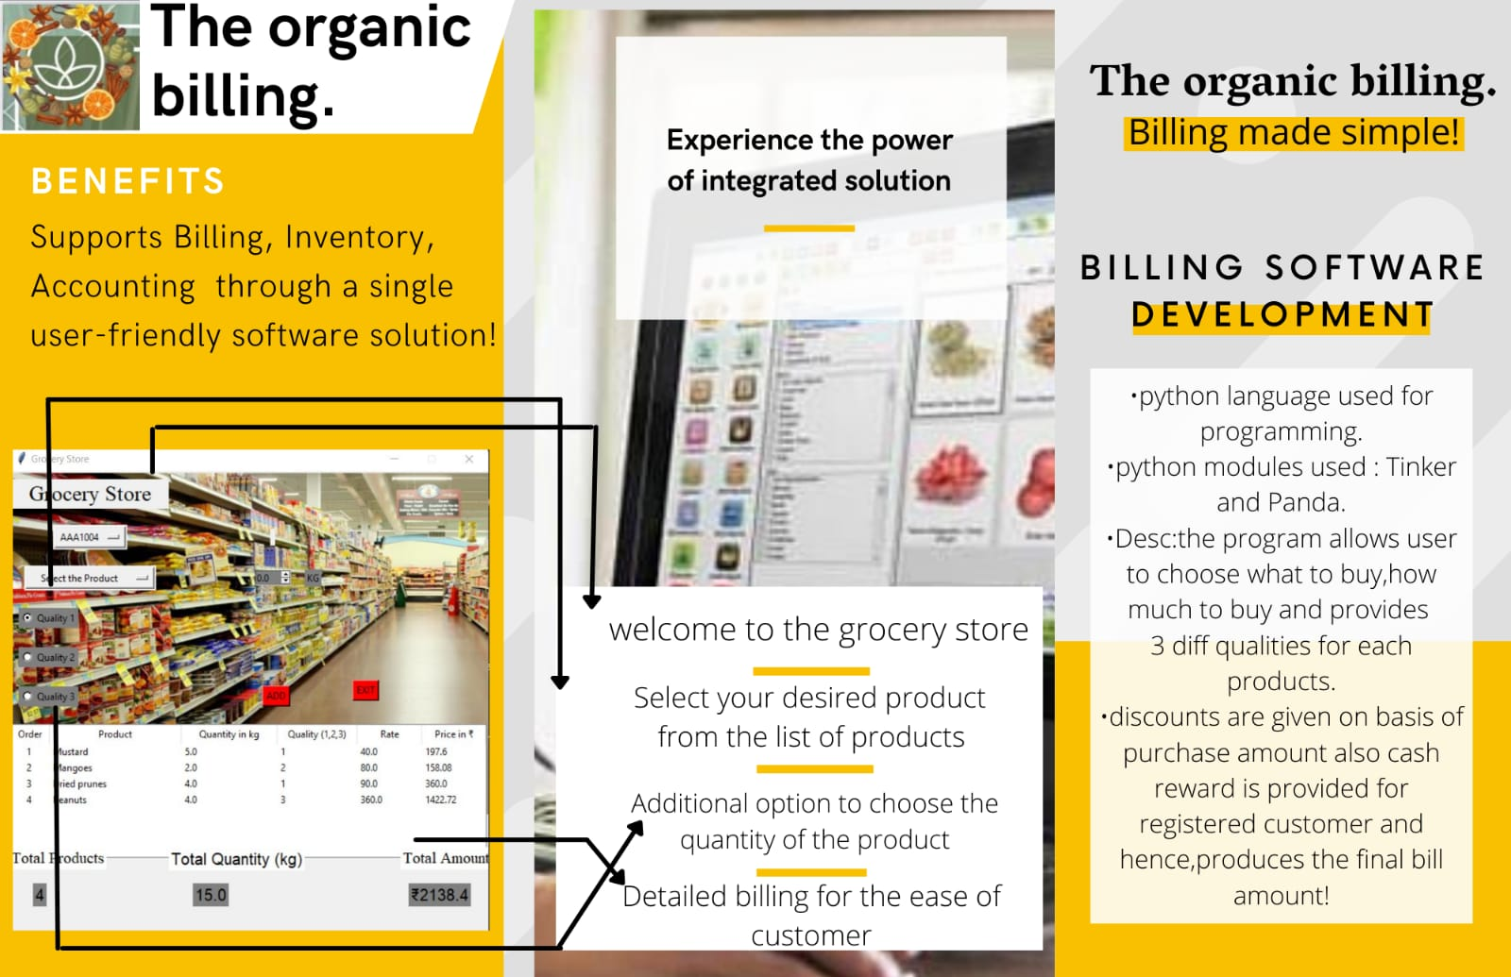
Tkinter

Slide 4
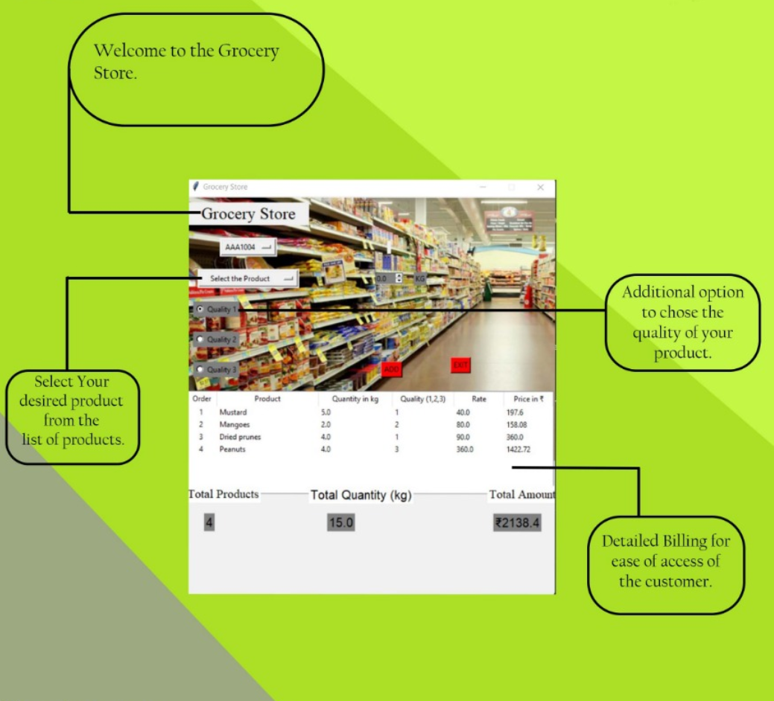
OUTPUT OF THE PROGRAM
Additional option to choose the quality of the product

Slide 5
Design of this project is quite simple and it makes sure that the user doesn’t face any sort of difficulties while using it.
TEAM MEMBERS:
1) ASHIQ
2) SHRUTI
3) BHAVINI
4) MOHIT
5) VASU
6) SOHAM ADONI
7) ASHISH
Thank You!

